Slide 1
Ad Serving Capabilities 1
Scoping Doc
Updated 12-May-2020

Slide 2
Intro to ASC1 Project
The SDAB project in R35 was intended to enable the KOKO Fuel business to target ad campaigns by KP location (cohorts A/B), the number of fuel dispenses, as well as the dispense amount. However, ad serving by the dispense amount was not properly scoped and therefore not delivered. Ad targeting by the KP location (Cohort A/Cohort B) on the other hand was inadequately delivered in the KP software.
The purpose of this project therefore, is to plug the gaps in the SDAB project and complete the capabilities required to enable KOKO Fuel to run their Dispense ad campaign for the 1st 6 KOKO Fuel customer refills.

Slide 3
ASC1 Project: Objective
To enable KOKO Media on behalf of KOKO Fuel, to serve Dispense ads on KPs based on:
The amount of money spent by the customer to buy KOKO fuel/volume of fuel in litres bought.
The location of the KP the customer is refilling at based on a cohort structure (Cohort A / Cohort B).

Slide 4
ASC1 Project: Scope
Send both site and audience keywords from the KP software to Ad Butler for ad targeting of Dispense ads.
Create targeting keywords for fuel dispense amount (duration) for ad targeting.
Send fuel dispense amount (duration) keyword from the KP app to Ad Butler.
Send KP serial as a keyword to Ad Butler for KP-level ad targeting.

Slide 5
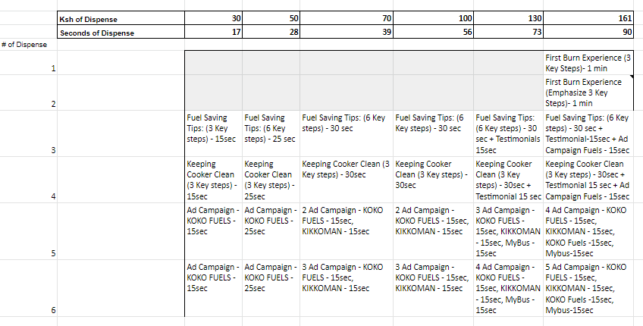
ASC1 Project: Dispense Ad Targeting By Refill Amount
Dispense amount (KES)
Dispense # already available for Dispense Ad targeting.

Slide 6
ASC1 Project: Dispense Ad Targeting By KP Location (Cohorts)
COHORT A (PARTICIPATING NEIGHBOURHOODS) | COHORT B (PARTICIPATING NEIGHBOURHOODS)
Athi River | Githurai 45
Babadogo | Huruma
Bahati | Imara Daima
Buruburu | Industrial Area
Dandora Phase 1 | Jerusalem Jericho
Dandora Phase 2 | Juja
Dandora Phase 3 | Kahawa
Dandora Phase 4 and 5 | Kahawa West
Donholm | Kaloleni
Eastleigh | Kangemi
Eastleigh Section 3 | Karen
Embakasi (Fedha, Nyayo,Tasia) | Kariobangi North
Gatina | Kasarani
Githurai 44 | Kawangware
 | Kayole

Slide 7
ASC1 Project: Technical Considerations
There are both Site (KOKO agent) and Audience (KOKO Fuel customer) keywords sent from the KM DMP to the KP software for ad targeting. Currently, only Audience keywords are sent to Ad Butler from the KP software for the Dispense Ads screen. This has limited the ability to target Dispense Ads by both Site and Audience keywords and must be fixed for this feature to work.
The Dispense amount metric can be determined within KOKO Core and transmitted to Ad Butler for targeting by the KP software, nullifying the need for DMP development.

Slide 8
Customer Refill Ad Targeting Journey
N/B: EXISTING FUNCTIONALITY (SDAB)
START THE REFILL PROCEDURE AT THE KP (SELECT REFILL AMOUNT AND START REFILL).
DETERMINE THE CUSTOMER REFILL NUMBER E.G. REFILL_1
DETERMINE KP LOCATION (COHORT NAME) E.G. COHORT_A
DISPLAY DISPENSE AD CAMPAIGN BASED ON THE TARGETING KEYWORD COMBINATION.
SEND ALL TARGETING KEYWORDS TO AD BUTLER FOR AD CAMPAIGN TARGETING.
DETERMINE THE FUEL REFILL AMOUNT E.G. AMOUNT_30
SAMPLE KEYWORDS GENERATED:
DISPENSE_1, COHORT_A, DISPENSE_30
(1ST DISPENSE, COHORT A, KES 30 DISPENSE AMOUNT)

Slide 9
Dispense Ads Targeting Flow
DISPENSE AD CAMPAIGNS ARE SET UP ON AD BUTLER FOR EACH CUSTOMER PROFILE
TARGETING KEYWORDS FOR EACH CAMPAIGN ARE SET UP ON AD BUTLER
WHEN THE CUSTOMER DISPENSES FUEL AT THE KP, TARGETING KEYWORDS ARE GENERATED FOR HIM/HER
THE KP DISPENSE SCREEN DISPLAYS THE RETURNED AD TO THE KP SCREEN
AD BUTLER COMPARES THE KP KEYWORDS TO THE CAMPAIGN KEYWORDS AND RETURNS THE CORRECT AD FOR DISPLAY
THE DISPENSE AD SCREEN LOADS, WHICH APPENDS THE KEYWORDS TO THE AD ZONE TAG AND SENDS IT TO AD BUTLER

Slide 10
User Stories (KOKO Fuel Customer)
As a customer, I should be able to view customized Dispense ads based on the amount of money I’m paying for my KOKO fuel refill/or on refill amount by volume.
As a customer, I should be able to view customized Dispense ads based on the location of the KP I’m using to refill my KOKO fuel (Cohort A / Cohort B).

Slide 11
User Stories (KOKO Media)
As an advertiser, I should be able to determine the location of the Dispense KP by cohort (Cohort A/Cohort B) and use the appropriate keyword to select the correct Dispense ad bucket to display to the KP customer.
As an advertiser, I should be able to determine the Dispense amount and use the appropriate keyword to select the correct Dispense ad bucket to display to the KP customer.

Slide 12
Concerns And Questions
Technical:
Which specific keywords should be used to determine the amount of money paid for KOKO fuel refill?
How to send both Audience and Site keywords to Ad Butler from the KP software?
How do we determine the amount keyword for KOKO fuel refills with custom amounts not available in the Dispense amount screen?
Should we generate amount keywords in terms of cash (KES) or time (Seconds)?
Process / Ops:
How do we set up Dispense campaigns on Ad Butler to capture multiple targeting scenarios (Amount, Cohort)?
Reporting:
Comparison of messaging impact between cohorts?
Performance comparison by refill amounts?

Slide 13
Relevant Links
Pre-scoping document
1-pager
WP: Dispense Ad Project
DMP: 6th Refill Use Case

Slide 14
Kyrellos B. Nyawallow
k.nyawallow@kokonetworks.com

